Slide 1
Public Sentiment Toward the NFL Can it predict weekly Fantasy Football outcomes?
Ryan Timbrook
Diego Vales
David Madsen

Slide 3

Question and Problem to Solve
Business Driver
NFL revenue grew an estimated $900 million to $14 billion in 2017, in 2018 it generated about $15 billion.
Fantasy football and the spread of legalized sports betting across the U.S. promises to lock in fans and keep them focused on the game.
As a Fantasy football player, how can Data Science help me make the most intelligence selections when deciding my weekly roster? “How do I win more?”
Problem to Solve
Identify if real-time public popular opinion on NFL teams, players, and coaches is a predictor of their weekly fantasy football stats.
About the Data:
Text data will be mined from three primary sources
Fantasy football websites like Yahoo Sports: https://sports.yahoo.com/fantasy/
Twitter Social Media API streams
Facebook Social Media API streams

Slide 4
Questions?

Slide 5

Topic Modeling
Tweets
Player, Team, Coaches, Approaches
As files
As content
Significance of emojis
Results
Included
Filtered

Slide 6
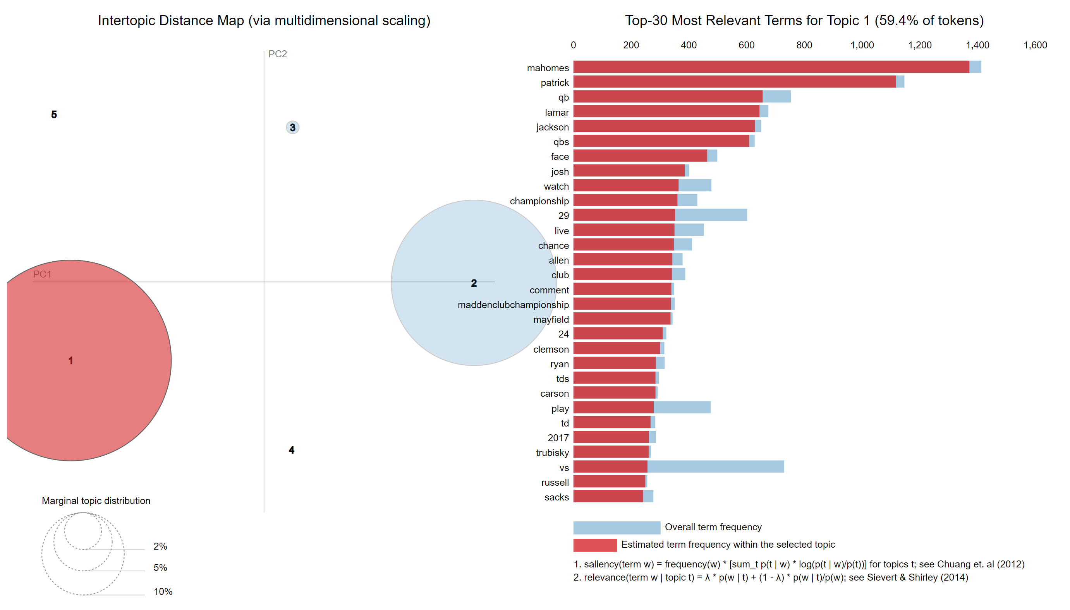
Topic Modeling - Files

Slide 7
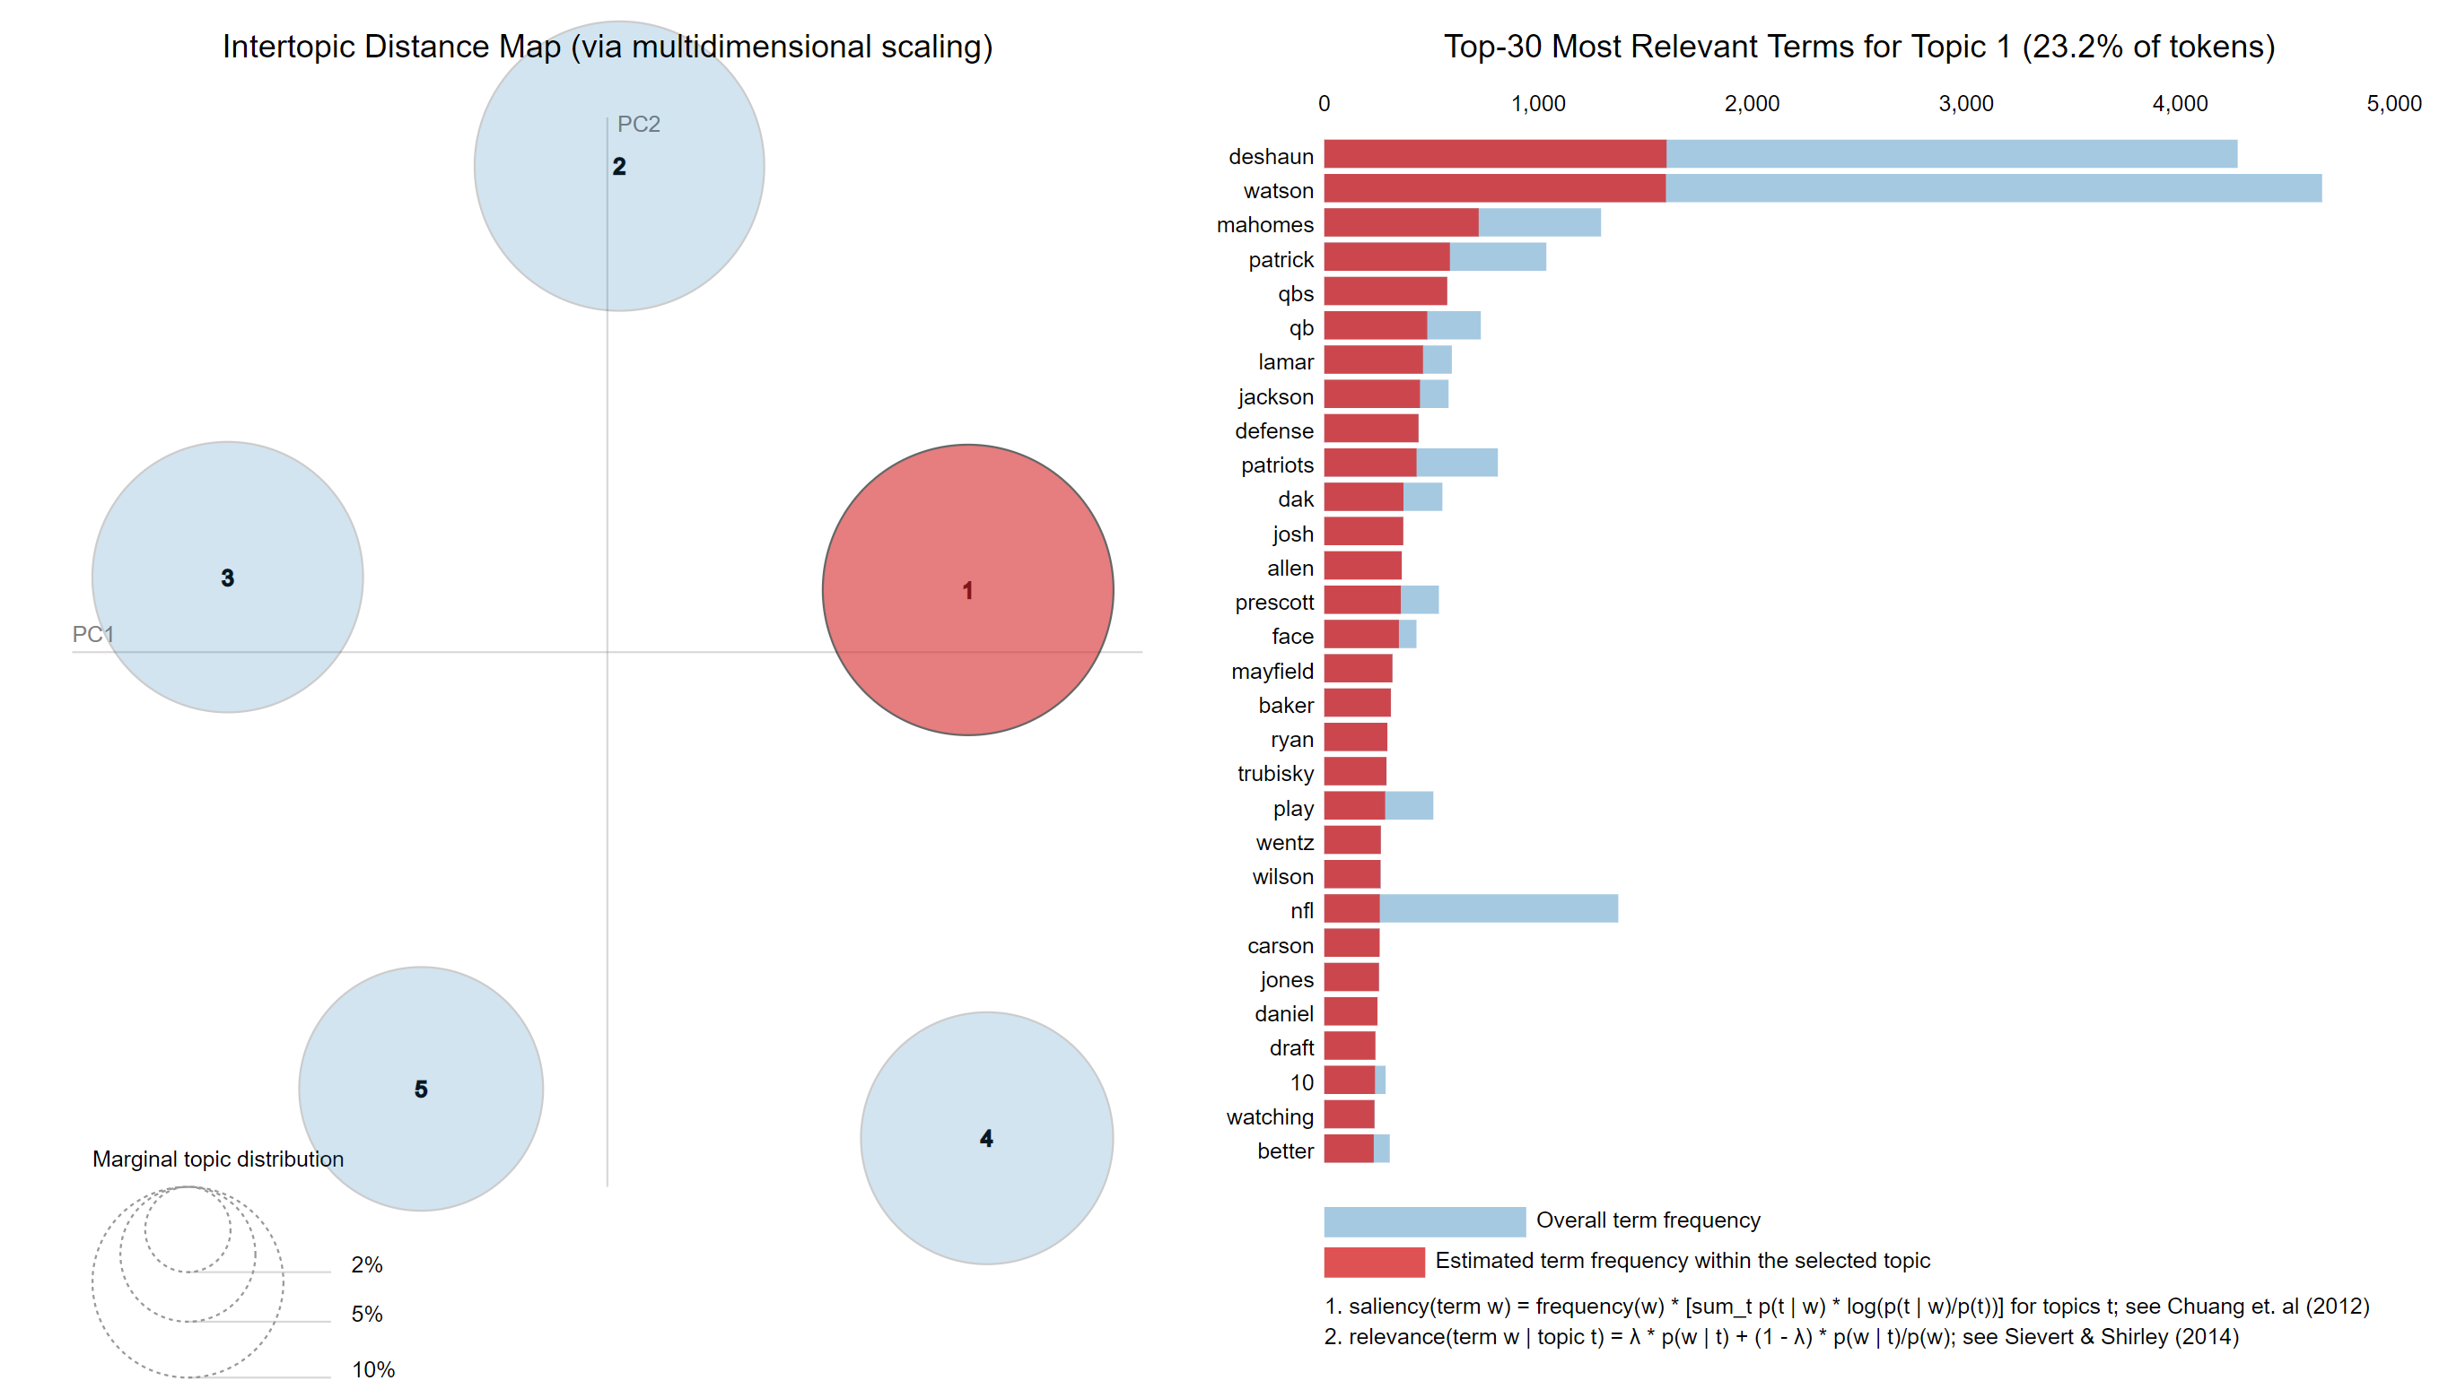
Topic Modeling - Content

Slide 8
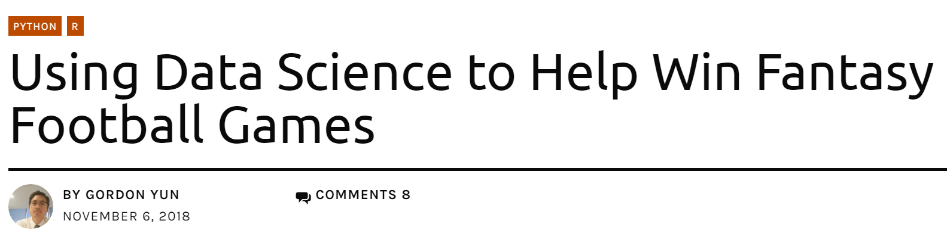

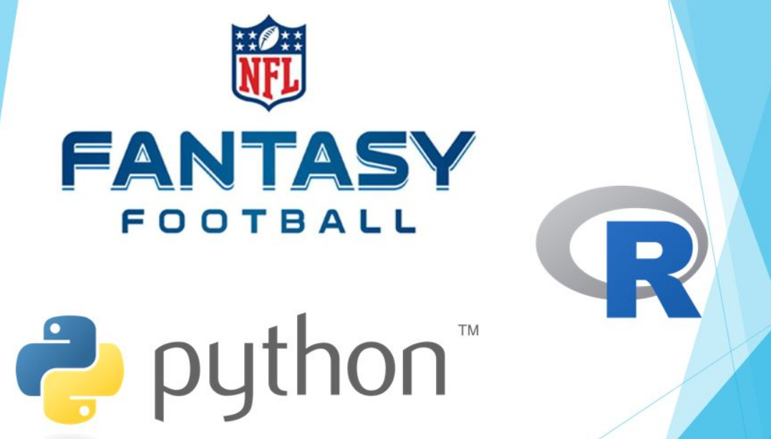
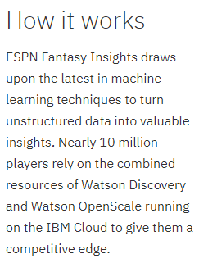

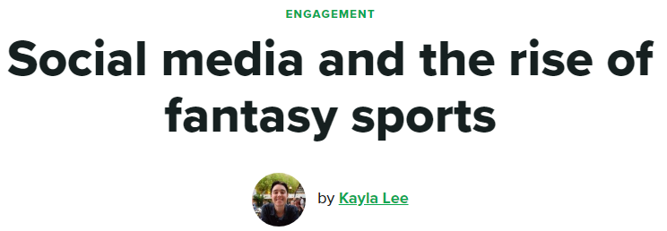

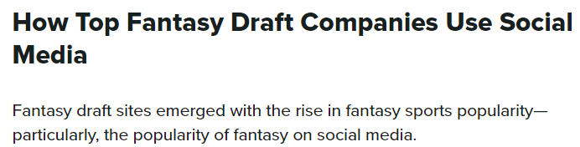

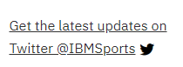
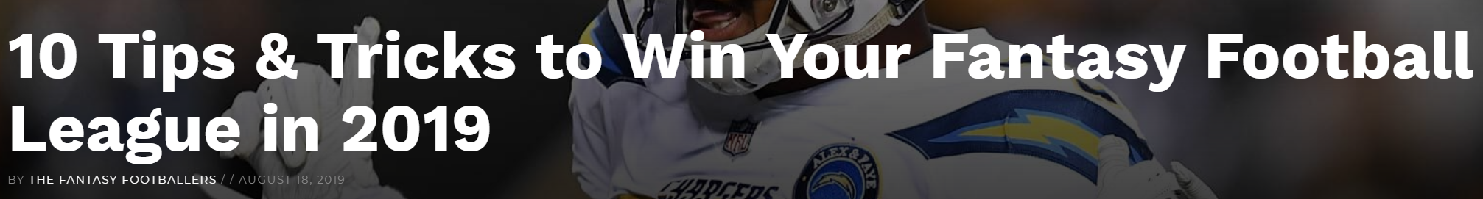
Data Science to help you win…

Slide 9
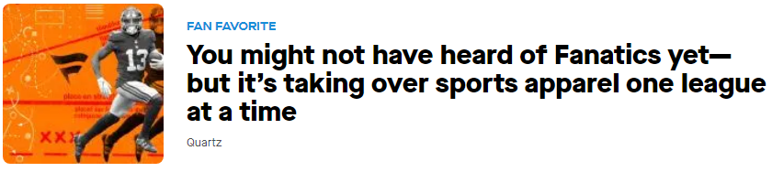
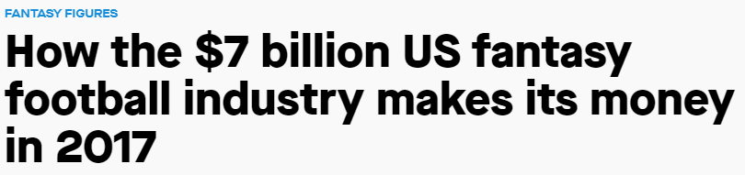
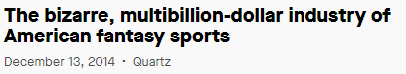
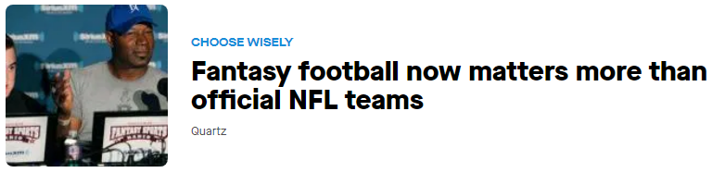
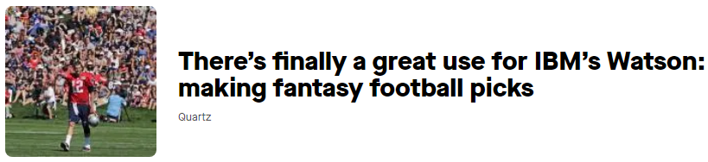
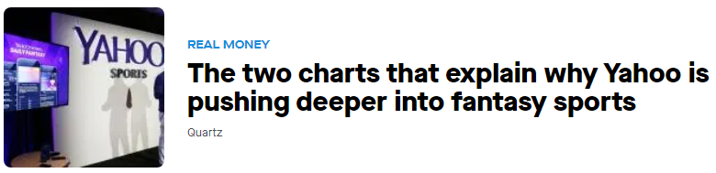
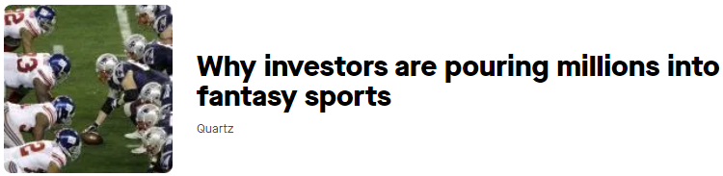
Media Headlines

Slide 10
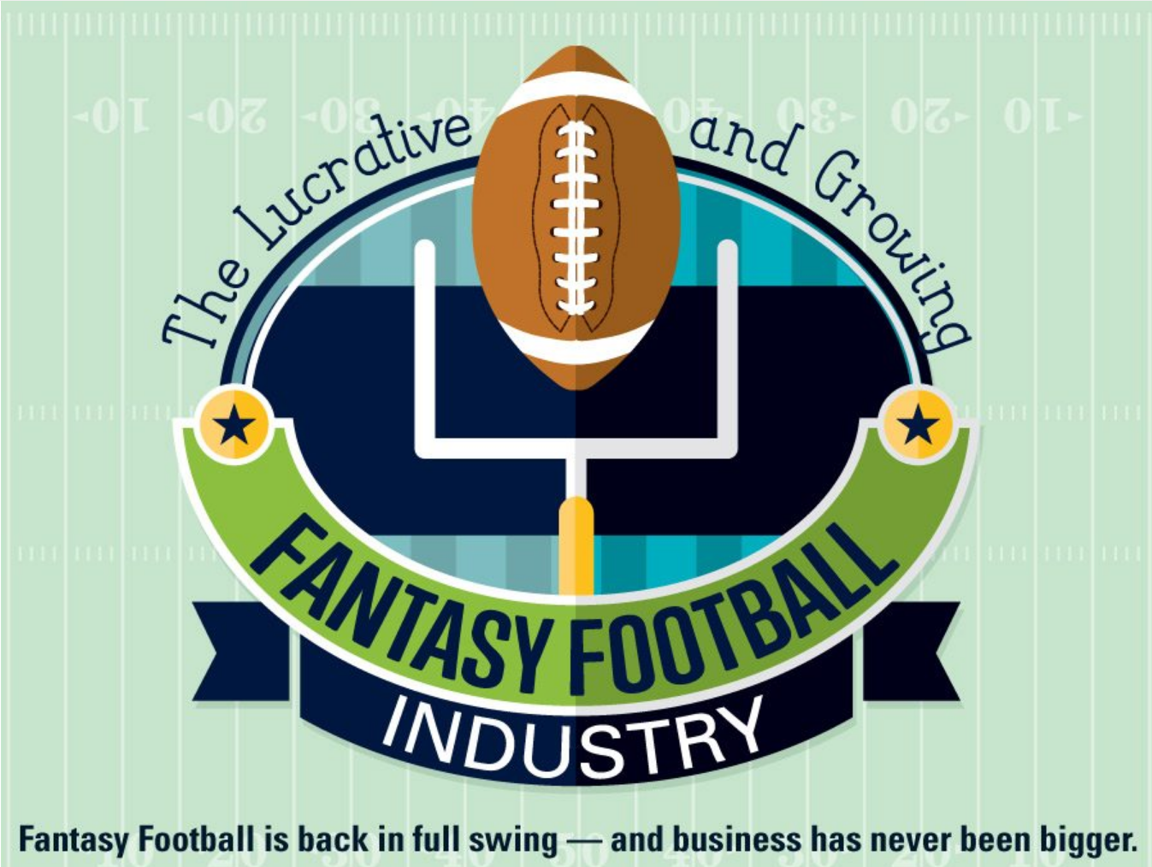
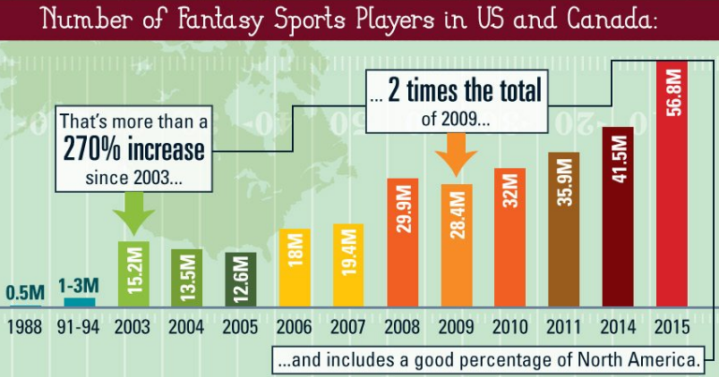
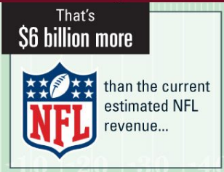
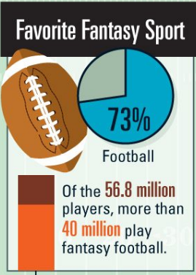
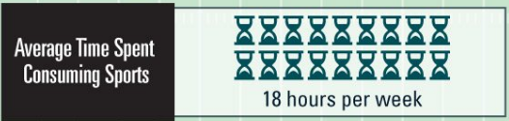
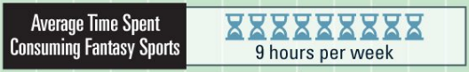

Fantasy Football Industry

Slide 11

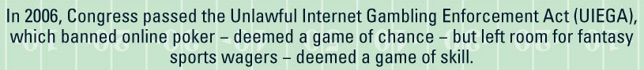
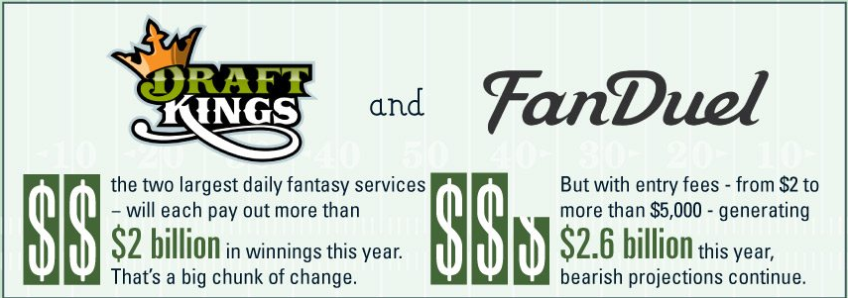
Fantasy Football Industry

Slide 12












Notable Fantasy Football Brands

Slide 13
Questions?

